Slide 1
The 8th Amendment
Excessive bail shall not be required, nor excessive fines imposed, nor cruel and unusual punishments inflicted.
1. What do you think was meant by the words “cruel and unusual” when it came to punishing an offender of the law?
2. In your opinion, what should the purpose of punishment be?
3. In the centuries before the ratification of the Constitution, Europeans had developed all kinds of methods of punishment for those who broke the law. Why do you think the framers of the Constitution wanted to do away with the kinds that were considered to be “cruel and unusual”?

Slide 2

Criminal Justice Process - Sentencing
An outside shot of Eastern State Penitentiary in Philadelphia, PA

Slide 3

Purposes of Sentencing
Retribution
1) “punishment” for wrongdoing
2) in our system, it is the courts who punish someone responsible for criminal action (instead of the victim punishing the offender)
As much fun as it would be to have guys like V (above) dispensing justice to criminals, our society gives power to the courts to exert retribution on criminal offenders

Slide 4
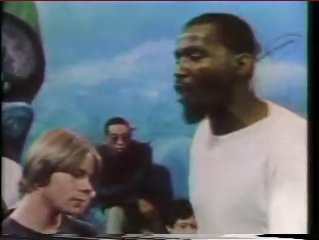
Purposes (cont’d)
Deterrence
1) a sentence is given to discourage criminal behavior
2) goal is to make offender not want to commit same crime again; also to warn others who might potentially commit the same crime
Some convicted criminals have participated in the “Scared Straight” program to show juvenile offenders the horrors of prison life as a deterrent

Slide 5
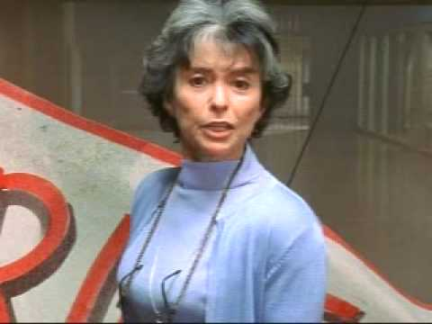
Purposes (cont’d)
Rehabilitation
1) helping offender change his/her life for the better
2) could include counseling programs, educational programs, etc.
Rita Moreno’s character Sister Peter Marie (from the TV series “Oz”) informed people of the drug rehab group sessions in Oswald State Penitentiary

Slide 6
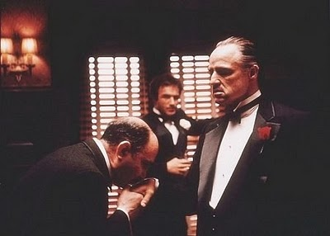
Sentencing Options
Suspended Sentence
1) sentence is given but defendant does not have to actually be served
2) Sentence CAN be enforced later if the convicted criminal does not stay out of trouble
3) convict is released but conviction remains on their permanent record
In the film The Godfather, Amerigo Bonasera (left) asks Don Vito Corleone (right) for justice after two young men received a suspended sentence for the battery and attempted rape of his daughter

Slide 7
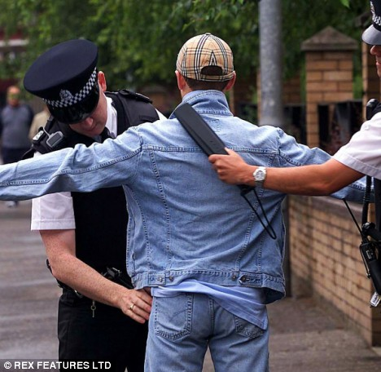
Options (cont’d)
Probation
1) defendant is released to the supervision of a Probation Officer
2) defendant agrees to certain conditions (getting a job, staying “clean”, etc.)
A probation officer performing a mandatory search for drugs on a defendant released to his supervision

Slide 8

Options (cont’d)
Home Confinement
1) also known as house arrest
2) defendant can only leave for certain circumstances; might be monitored by the police/court
In the HBO drama The Sopranos, Corrado “Uncle Junior” Soprano (above) was sentenced to house arrest after being convicted of federal racketeering charges

Slide 9

Options (cont’d)
Restitution & Work Release
1) restitution = defendant personally pays back damages caused to victim
2) work release = defendant is imprisoned but is allowed to leave for community work during the daytime hours

Slide 10
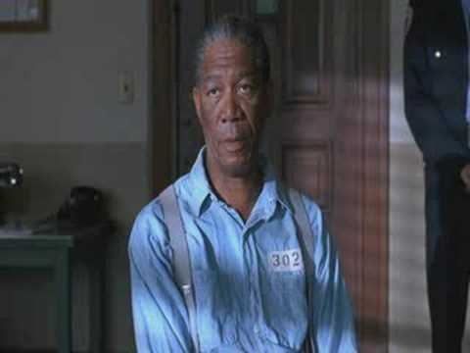
Options (cont’d)
Incarceration (Imprisonment)
1) definite sentence = judge specifies exact amount of time to be served (“5 years”)
2) indefinite sentence = defendant is given a minimum/maximum term (“no less than 3 years, no more than 7”)
3) defendant can be paroled if he/she shows signs of good behavior and rehabilitation
4) if a defendant commits a federal crime, he/she is not eligible for parole
In the film The Shawshank Redemption, Ellis “Red” Redding (above) is sentenced to life in prison with the possibility of parole. He is turned down time and time again by the parole board.

Slide 11
Mandatory Sentencing – “3 strikes and you’re out law” in CA
Like many other states who were trying to be tough on crime (Especially drug dealers), California adopted this law in 1994 along with many other states.
Proposition 36, a Change in the "Three Strikes Law" Initiative, was on the November 6, 2012 ballot as an initiated state statute, where it was approved.
Proposition 36:
Revises the three strikes law to impose life sentence only when the new felony conviction is "serious or violent".
Authorizes re-sentencing for offenders currently serving life sentences if their third strike conviction was not serious or violent and if the judge determines that the re-sentence does not pose unreasonable risk to public safety.
Continues to impose a life sentence penalty if the third strike conviction was for "certain non-serious, non-violent sex or drug offenses or involved firearm possession".
Maintains the life sentence penalty for felons with "non-serious, non-violent third strike if prior convictions were for rape, murder, or child molestation."
One impact of the approval of Proposition 36 was that the approximately 3,000 convicted felons who were as of November 2012 serving life terms under the Three Strikes law, whose third strike conviction was for a nonviolent crime, became eligible to petition the court for a new, reduced, sentence. Taxpayers could save over $100 million per year by reducing the sentences of these current prisoners and use the money to fund schools, fight crime and reduce the state’s deficit

Slide 12
California’s 3 Strike Law –
NY Times Op-Doc (5 min)
https://www.youtube.com/watch?v=pJotrsvQbNU

Slide 13
Burden of Proof – PBS Frontline
(7 min Youtube clip)
http://www.youtube.com/watch?v=dvK4rC0XQN0

Slide 14
The facts about Daniel Faulkner and Mumia Abu Jamal (10 min)
http://www.youtube.com/watch?v=sPvGHGTO1Ng&feature=related

